Slide 1

LetsGo App
UX2 Case Study | Brandon Norton
March 2023

Slide 2
Overview
Discover
Initial Brainstorm
Problem Statement
Competitive Analysis
User Research
Surveys
Insights
User Personas
Design
Initial Sketches
Wireframes
Journey Maps
Outcomes
Lessons Learned
Next Steps
Q&A

Slide 3
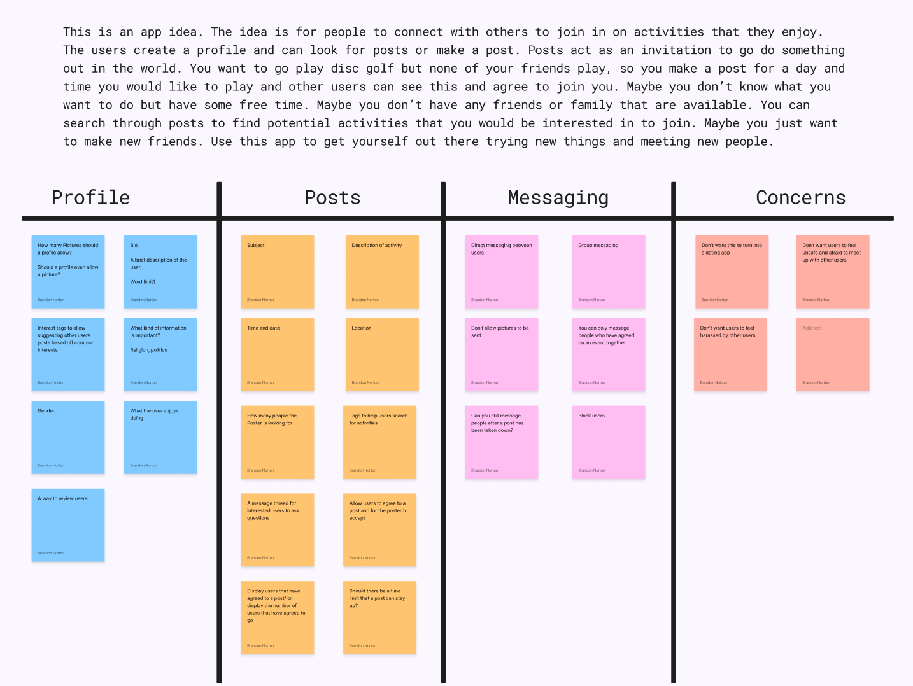

Slide 4

Problem Statement
An app that allows users to post events and search for events to join. Design how the posts will look, what information they will contain, how to create them and search for them, and how the posts will be displayed.

Slide 5





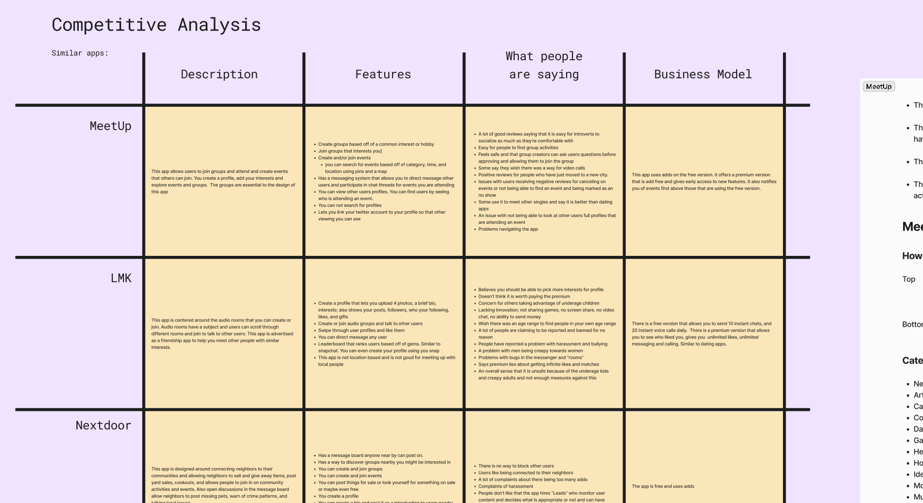
Competitive Analysis
Similar Apps
MeetUp
LMK
Nextdoor
Wink
Hinge

Slide 6
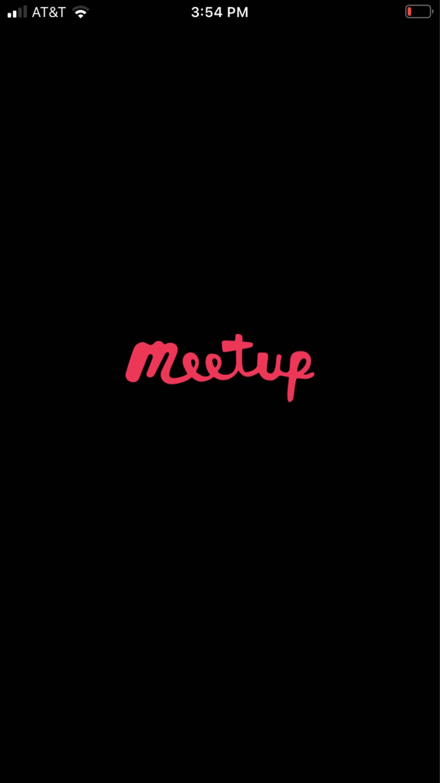
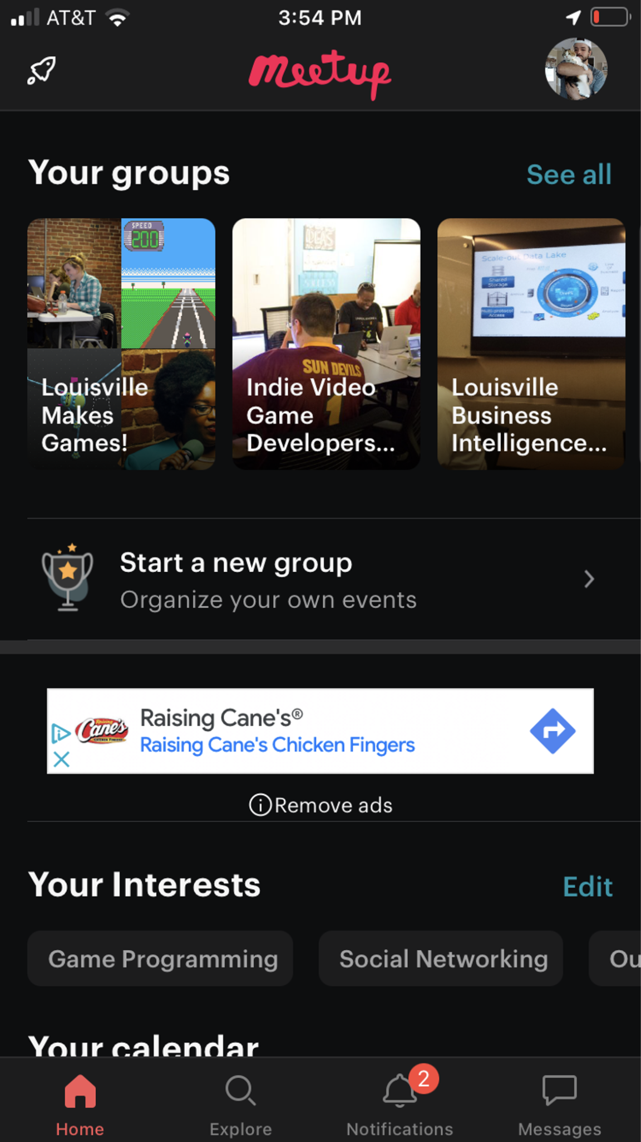
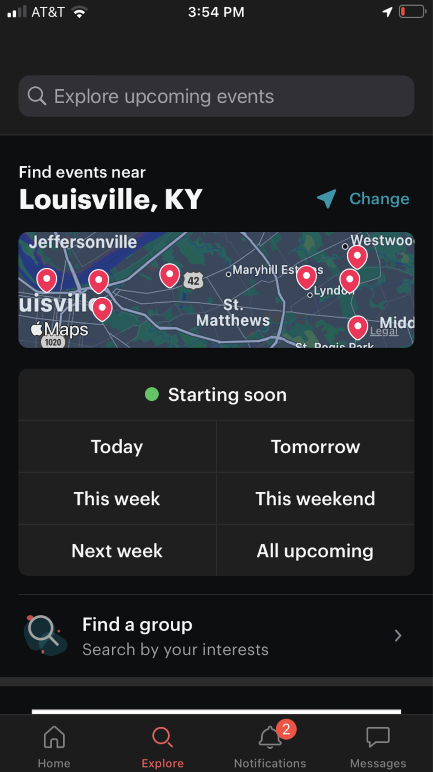
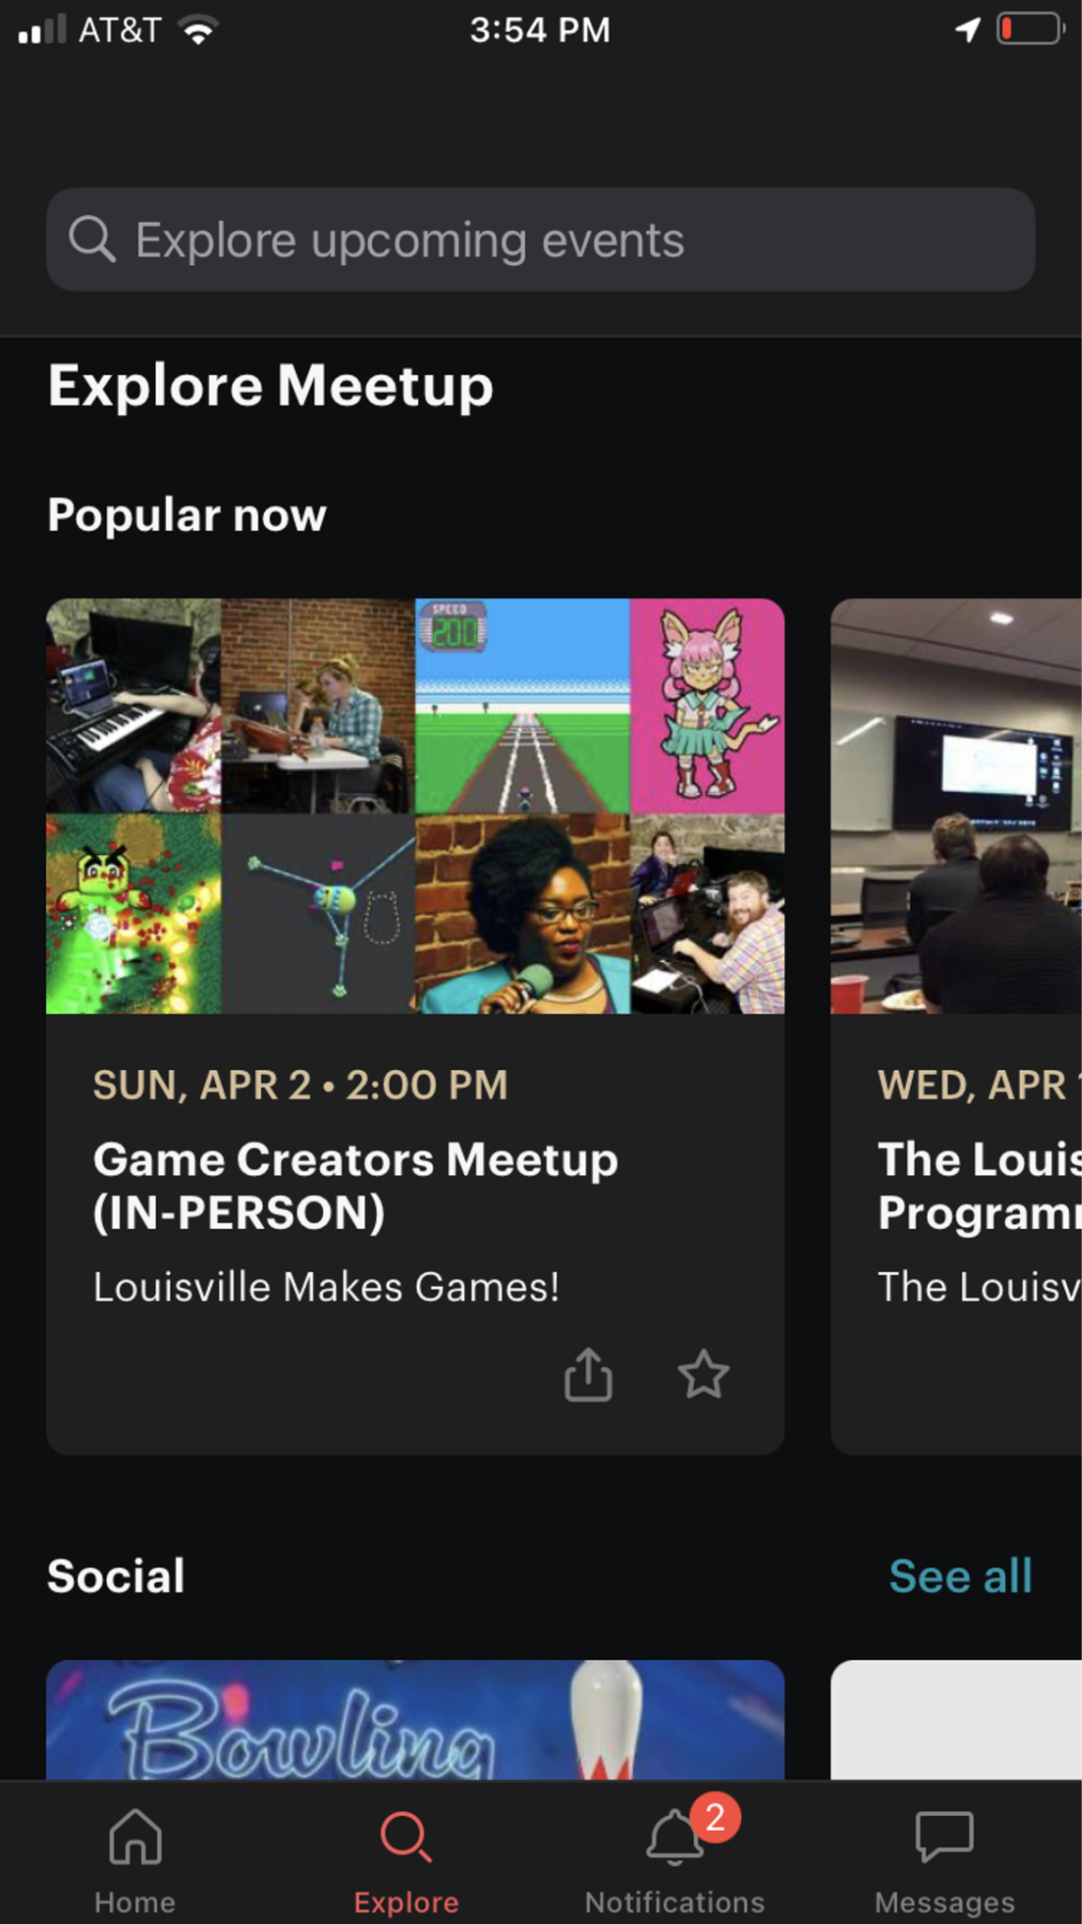
Competitive Analysis | MeetUp

Slide 7
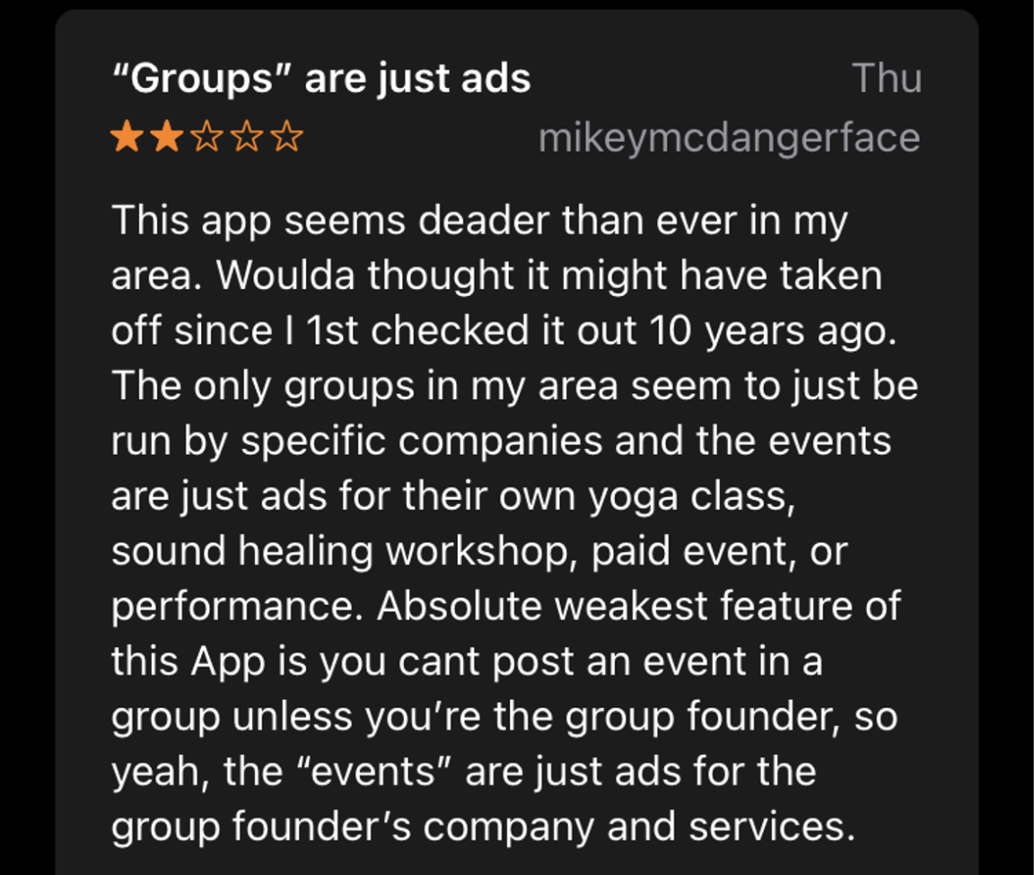
Competitive Analysis | MeetUp
The most similar to our idea
Is based around making and joining groups that host events.
This can be an intimidating aspect to someone who is just trying it out for the first time.
The UI is clustered and hard to navigate.
Uses adds on the free version.
Adds to clutter, annoys user.

Slide 8
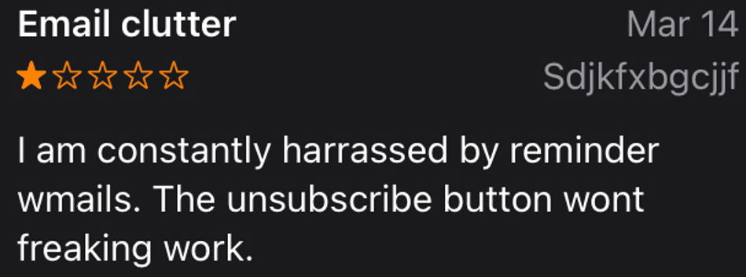
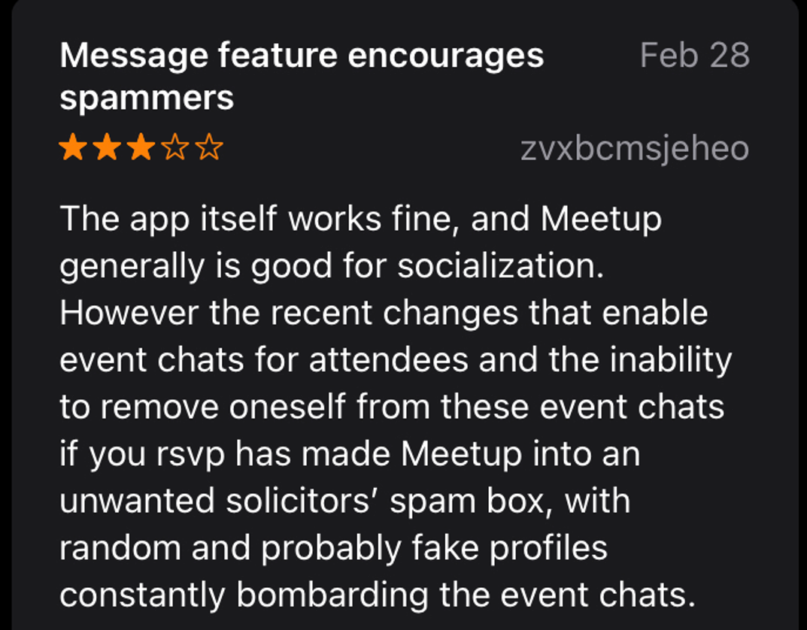
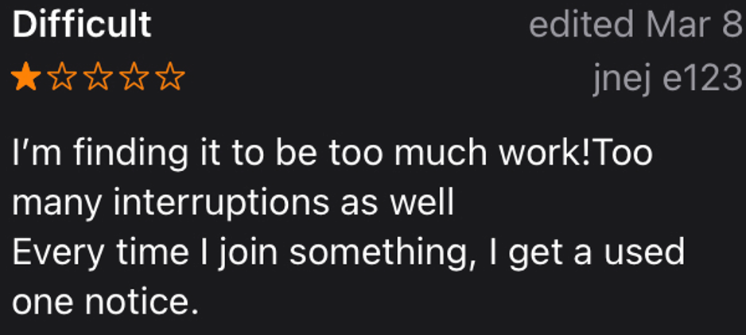
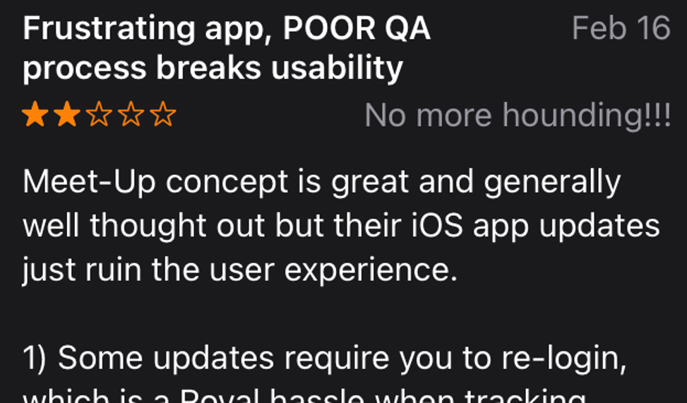
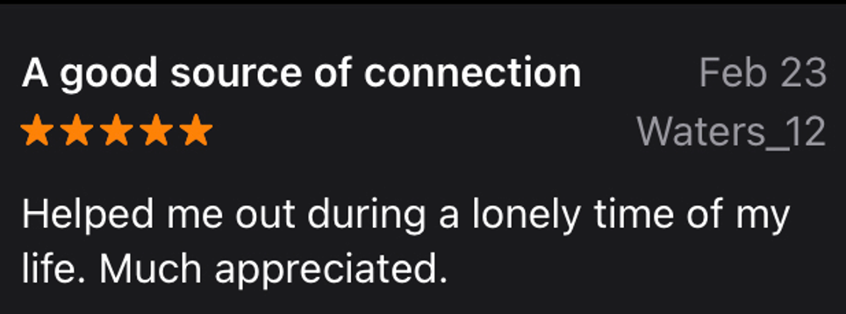
Competitive Analysis | MeetUp
Frustrations from a bombardment of notifications for events they don’t want to join or events and groups they have joined.
It does have its fair share of positive reviews for improving social lives.
A lot of poor reviews that acknowledge that it is a good concept.

Slide 9
Competitive Analysis | MeetUp
Lessons Learned
Should be more casual so people don’t feel intimidated to try it for the first time.
We want posts to be from real people not groups or companies hosting events.
Posts should not have hero images
You should not have to join or create a group to be able to create or join a event post.
Users should have control over notifications

Slide 10
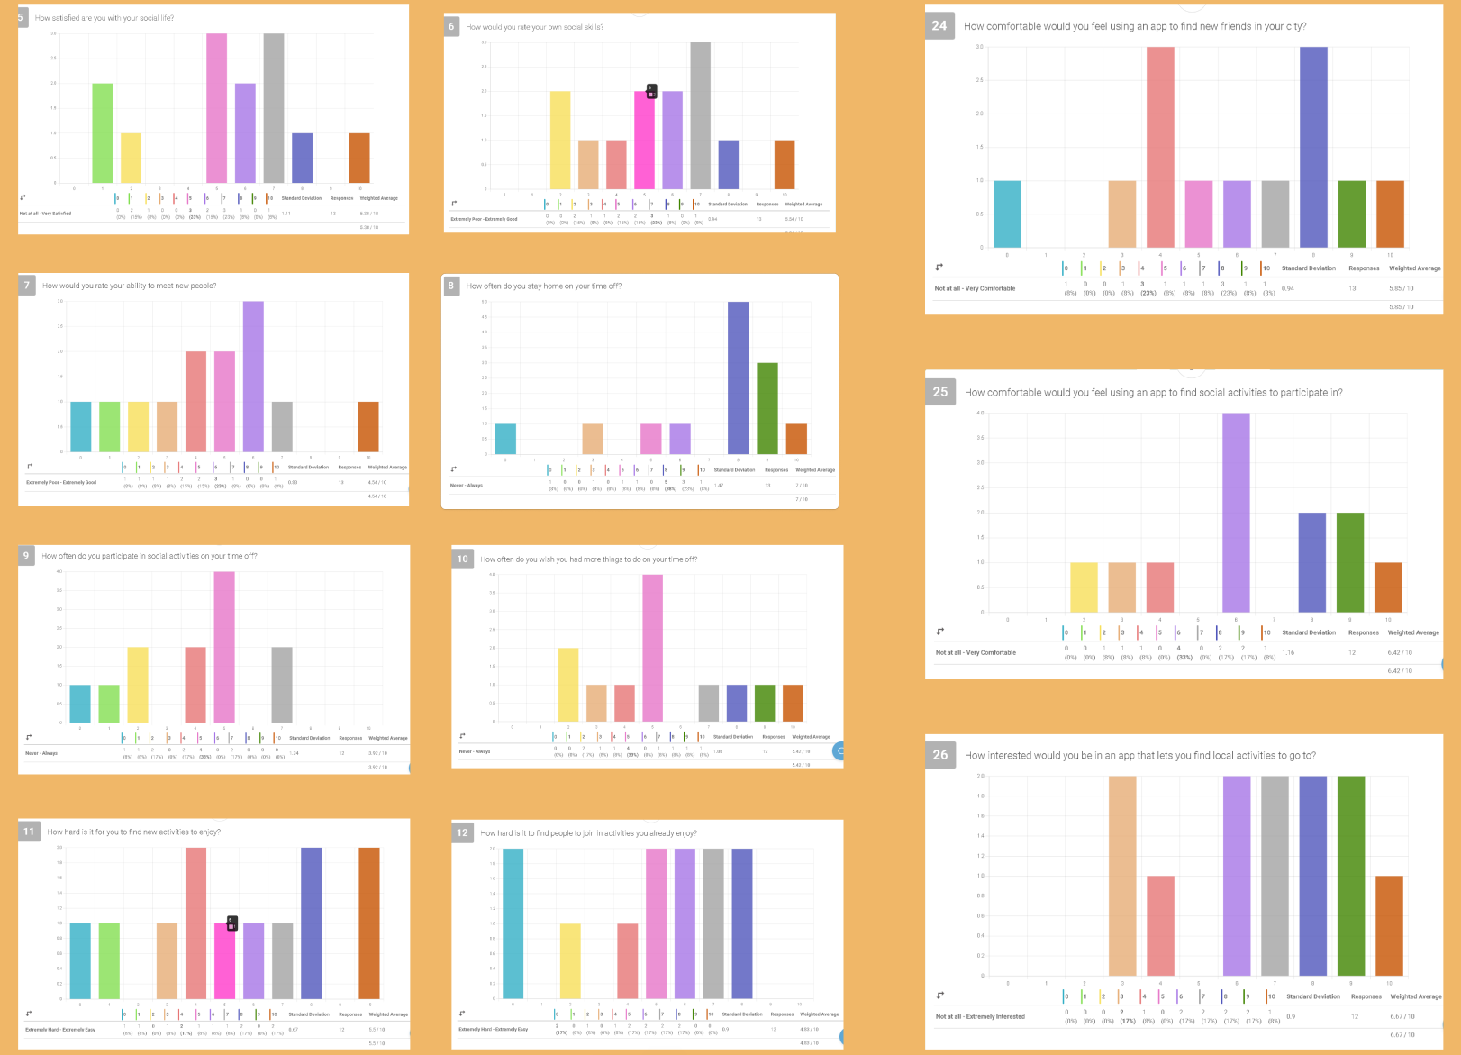
Surveys

Slide 11
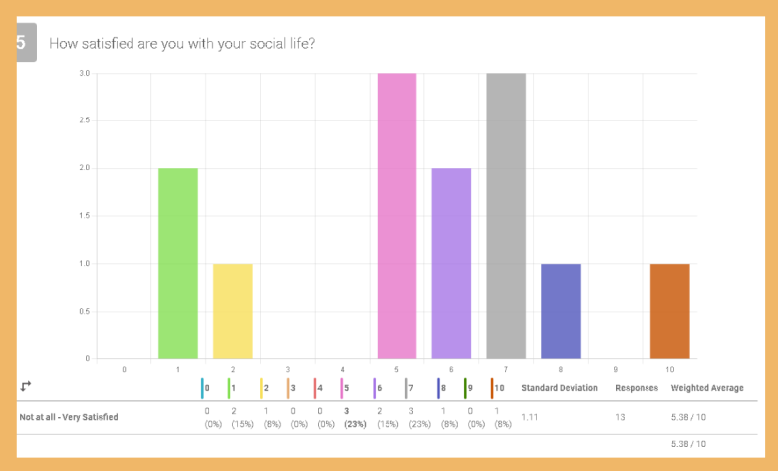
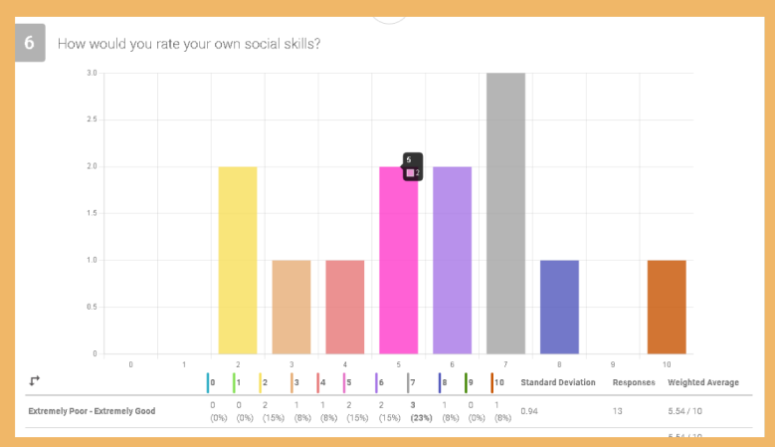
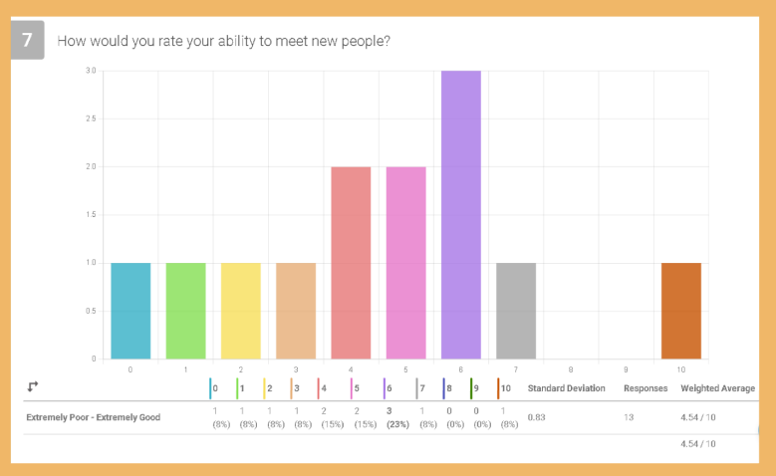
Quantitative
Most people are somewhat satisfied with their social lives.
Those that are not satisfied are very dissatisfied.
No one is very satisfied with their social life.
Most feel that they have above average social skills.
Even though people feel that they have social skills, they also mostly feel that they have a lack in ability to meet new people.

Slide 12
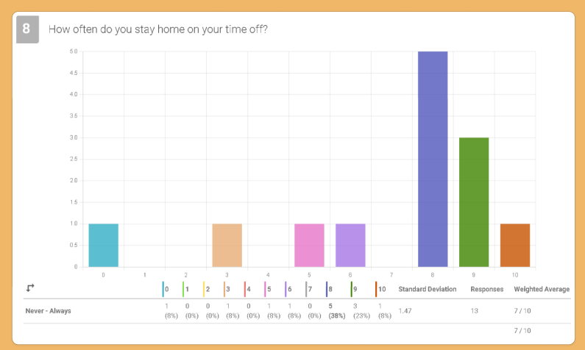
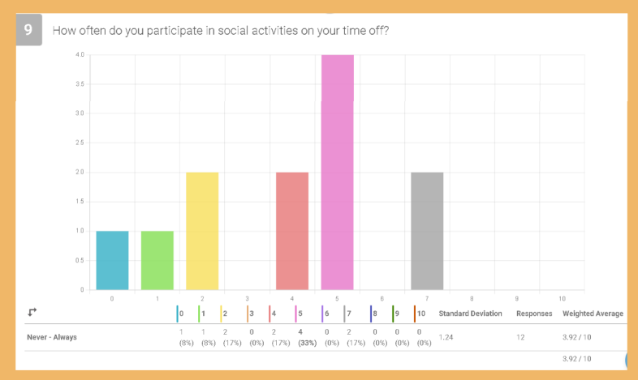
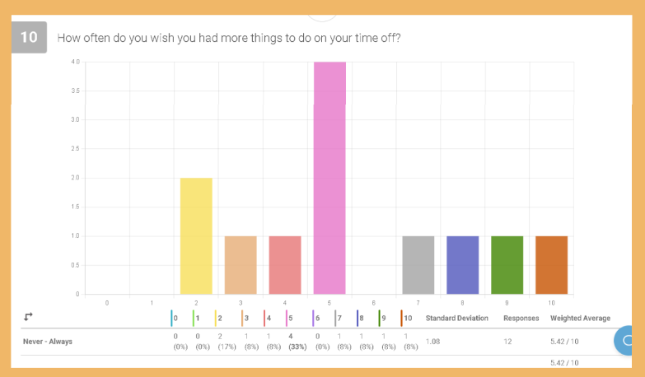
Quantitative
Most people have the habit of staying at home during time off.
Most people trend towards little to medium social activities on their time off.
People show a desire to participate in more activities.
Some showed strong desires to add more social activities to their life-styles.
No one said never.

Slide 13
“I'm excited to meet new people, but I dislike wasting time meeting people that I don't want to see again”
“Trying new things is important to continue living an exciting and challenging life”
Qualitative
Meeting new people
Most said they feel nervous and anxious.
Trying new things
Most people share an interest in wanting to try new things. Some are also nervous at the same time.
Activities
Most expressed a lack in social activities in their lives. Most wish for more activities to participate in. There was a desire for more structured activities (clubs: so that it is the same people every time)

Slide 14
Qualitative
Constraints
There was a concern for participating in large groups where they did not know anyone. There was a general issue of people not having time, energy, or friends. There was a concern for needing structure when they socialize. There was also the problem of living in rural areas where the drive was a factor in not going out. And of course, money was an issue.
Staying home
People wanted to stay home versus going out because they just wanted to relax. Some said their social activities are mostly online anyway so they didn’t need to leave home to socialize. Stay home to play video games. Others had to stay home because of responsibilities, including chores and looking after their children. Some stayed home because they have no one to hangout with or they live too far away from potential activities.
“(I’m) Scared to show up to larger group events alone and not have anyone to talk to”
“I wouldn’t mind joining a club or something. That way it’s the same people/activity every week, I know how much time and energy it’ll use, and I can plan around it.”

Slide 15
Qualitative
What to look for in new friends
Most said they look for someone with similar interests when making new friends. Very few said that politics where a factor and no one said religion was a factor. There was also a desire for other parents with similar aged children.
Hypothetical move to new city
There is a concern for finding friends and activities in a new city.
Results showed that some would not know how to find friends in a new city, others said they would meet people through work, or through different social media platforms (Bumble BFF, Facebook groups, reddit.
“Agreeing on politics isn’t important, but people who are too political or are hateful to the opposing side are really annoying. I think they’re Bad People and wouldn’t want to meet.”

Slide 16
Lessons Learned
Main concerns for people finding new activities and friends are social anxieties in meeting new people.
This is true for the already social and the non-social.
There was a fear in showing up to activities and not having anyone to talk to combined with the anxiety in making new friends.
This could inhibit someone from going to an event.
This exposes a need for people to have the ability to get to know one another before showing up.
This could include an open message board for each event and or a way to privately message between those that plan on attending an event together.

Slide 17
Lessons Learned
Another issue was needing structure and consistency.
This app was originally intended to be more spontaneous, but there could be a away to create events that are monthly, weekly, daily, etc.
This would allow groups to form without specifically having a group functionality.
These posts would keep an open message board that will be the central place for “members” or those looking to join to keep the impression that it is a group.
For recurring posts, there will need to be away to clear any inactive posts so the boards do not become cluttered. There will have to be some sort of validation for the poster to make sure that they are still active in these activities.

Slide 18
Lessons Learned
People also showed that they did not want to waste time meeting people they don’t like or share similar interests with.
Because of this there needs to be two types of events, public and private.
Public events will be open for everyone. This includes access to the messaging boards.
Private posts will hide sensitive information, and access must be granted by the Host.
Users can DM Host about event.
If the Host declines a request to join, then that event should no longer be visible to that user to prevent harassment.

Slide 19
User Personas

Slide 20
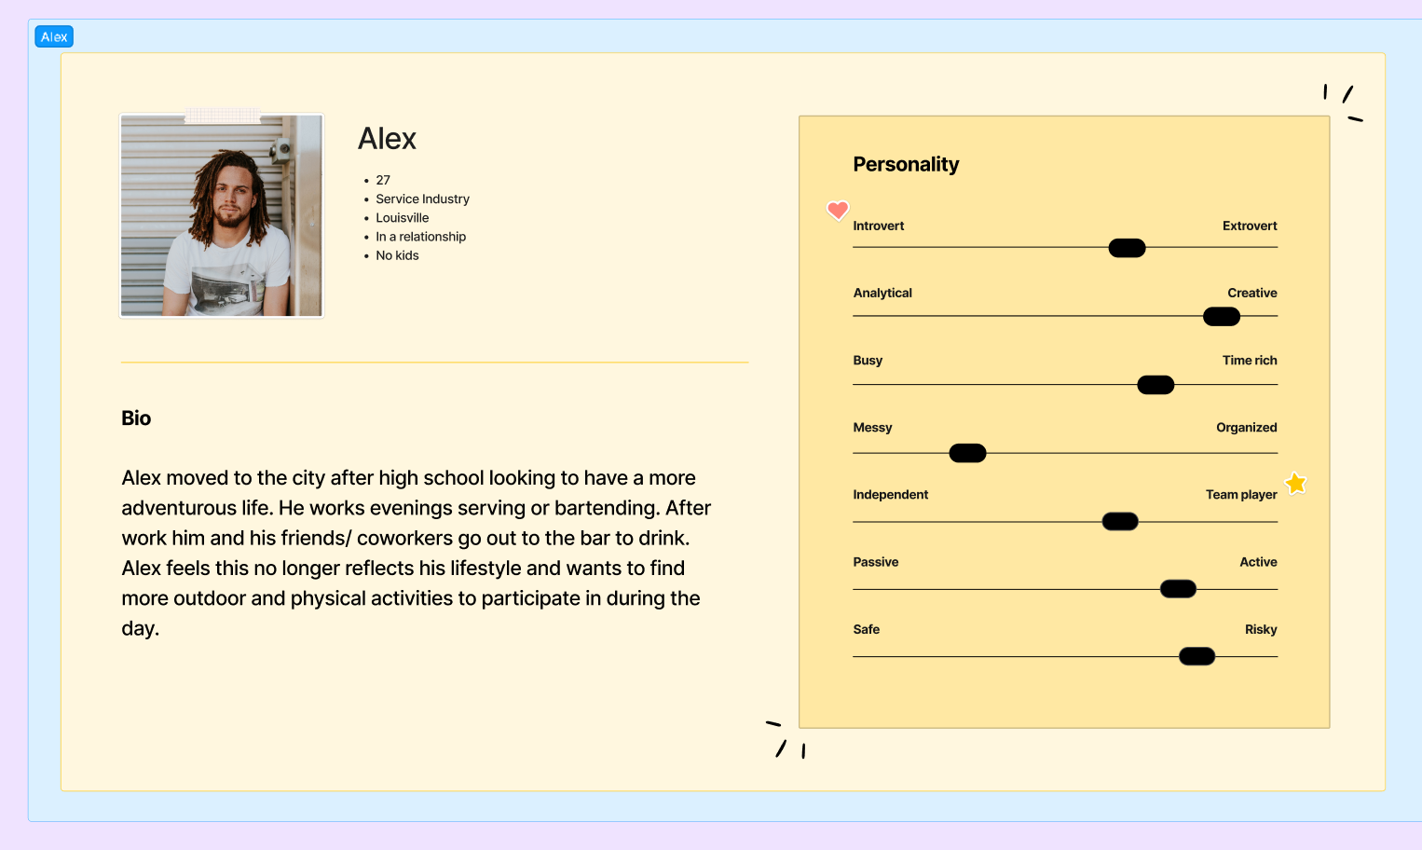

Slide 21
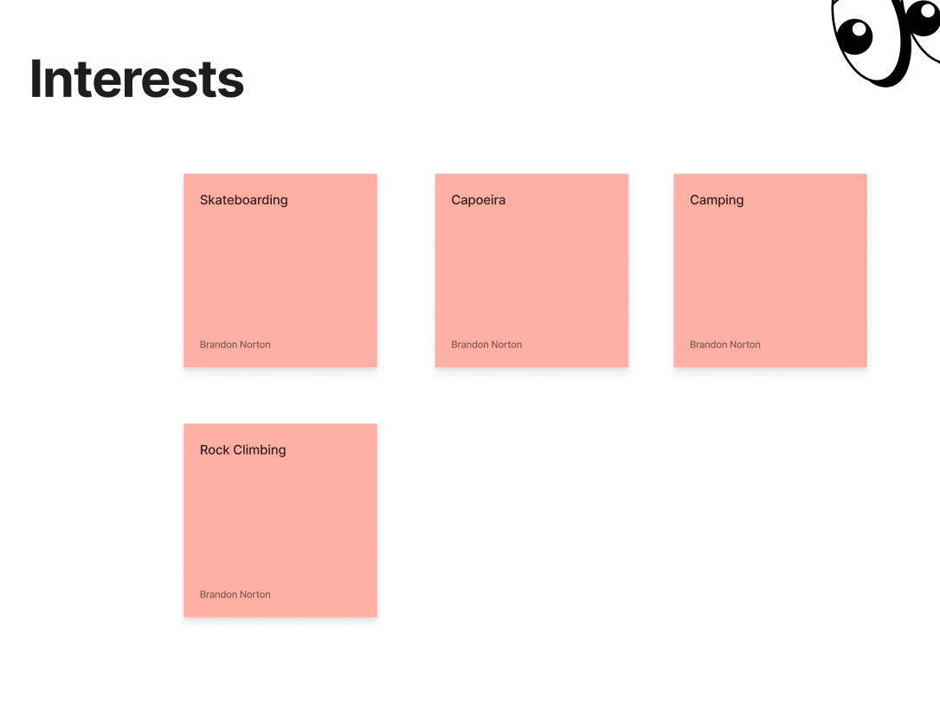
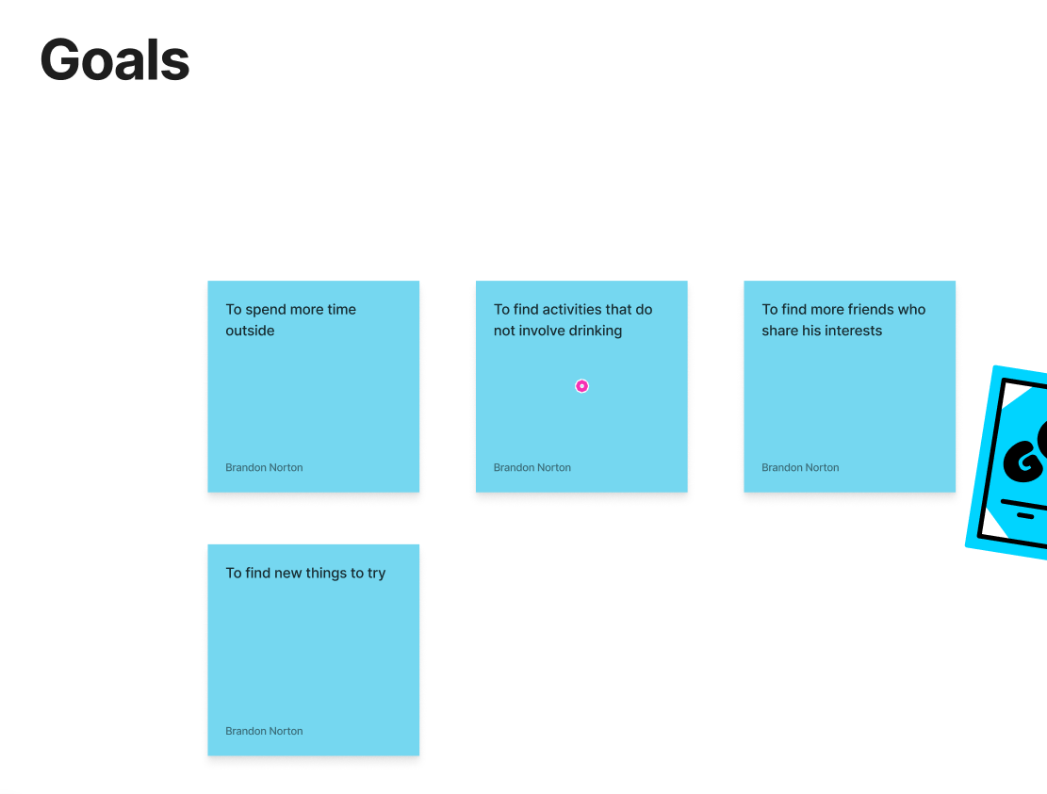
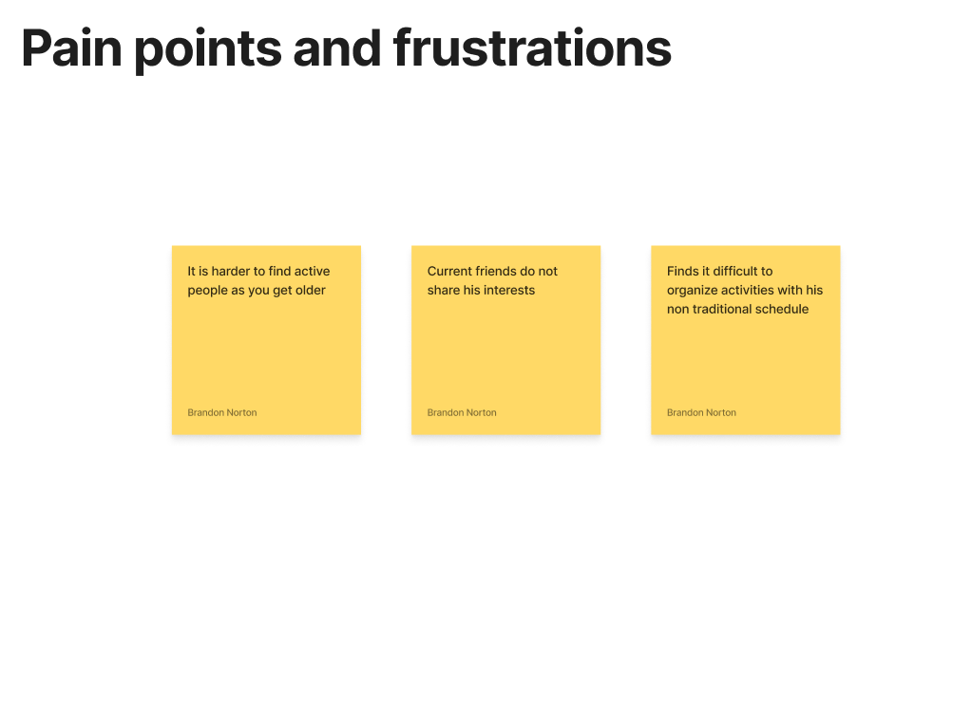
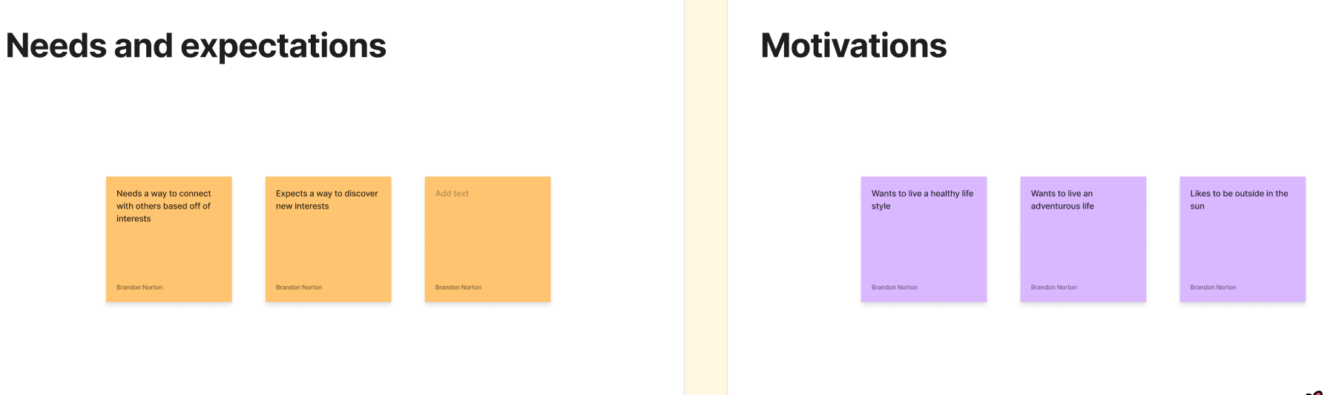

Slide 22
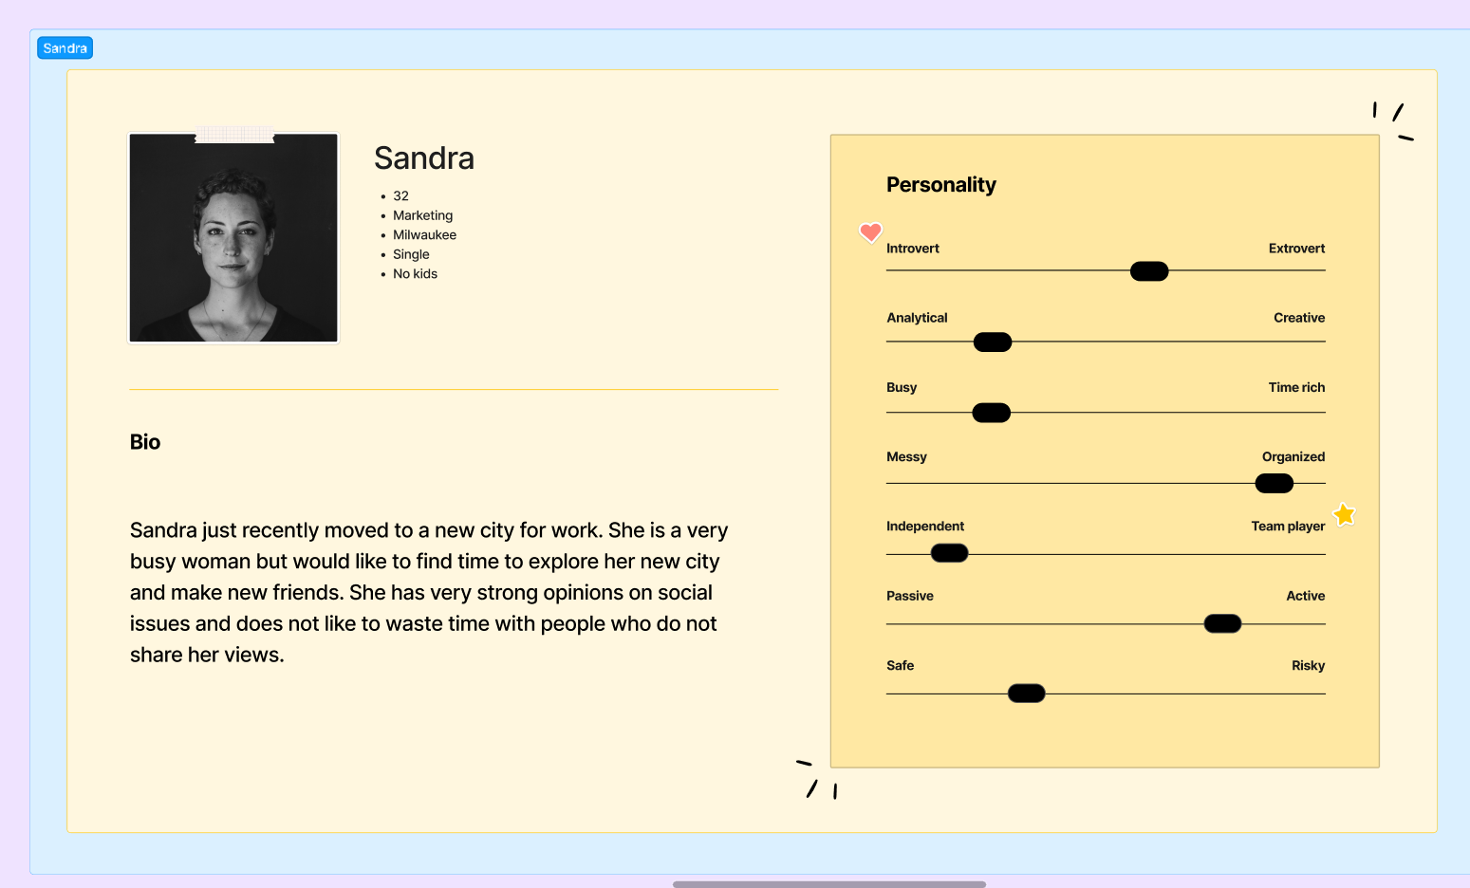

Slide 23
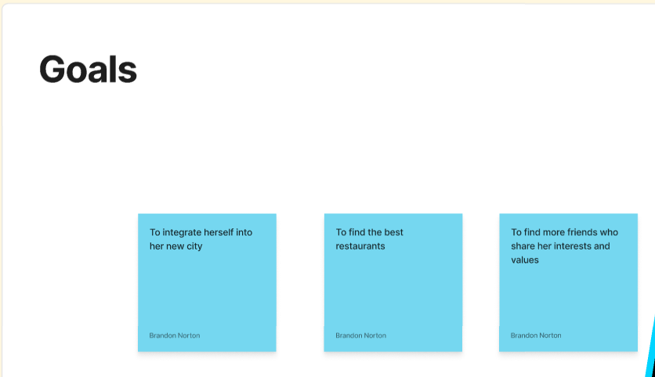
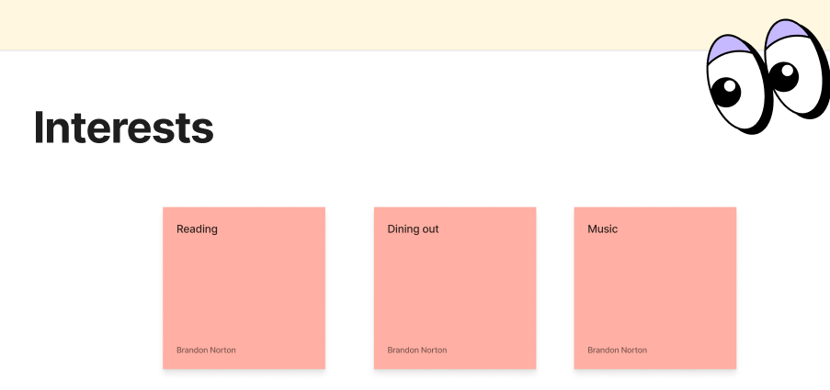
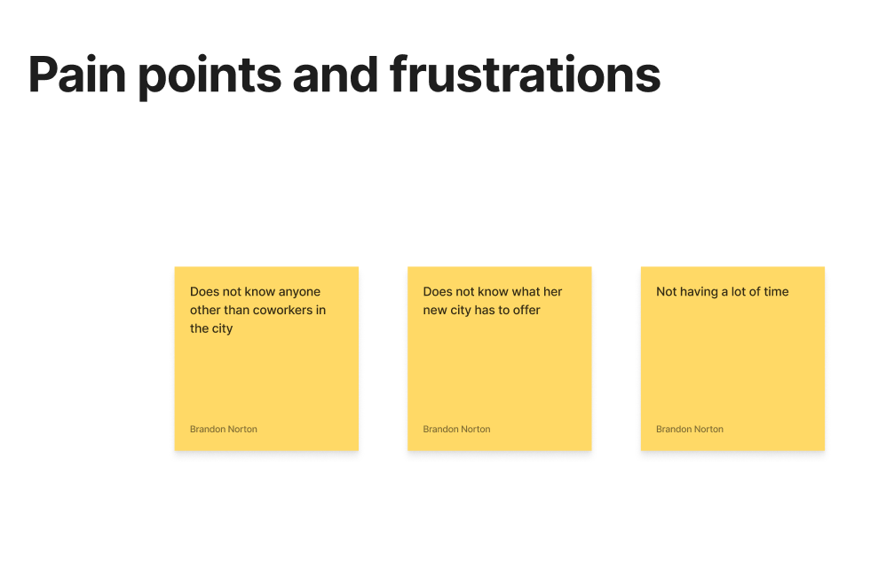
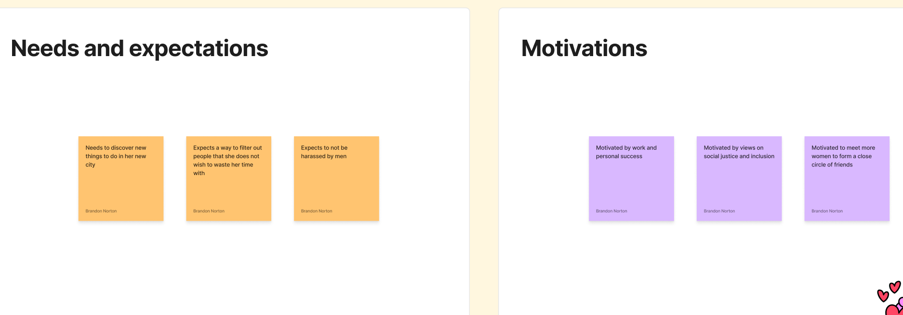

Slide 24
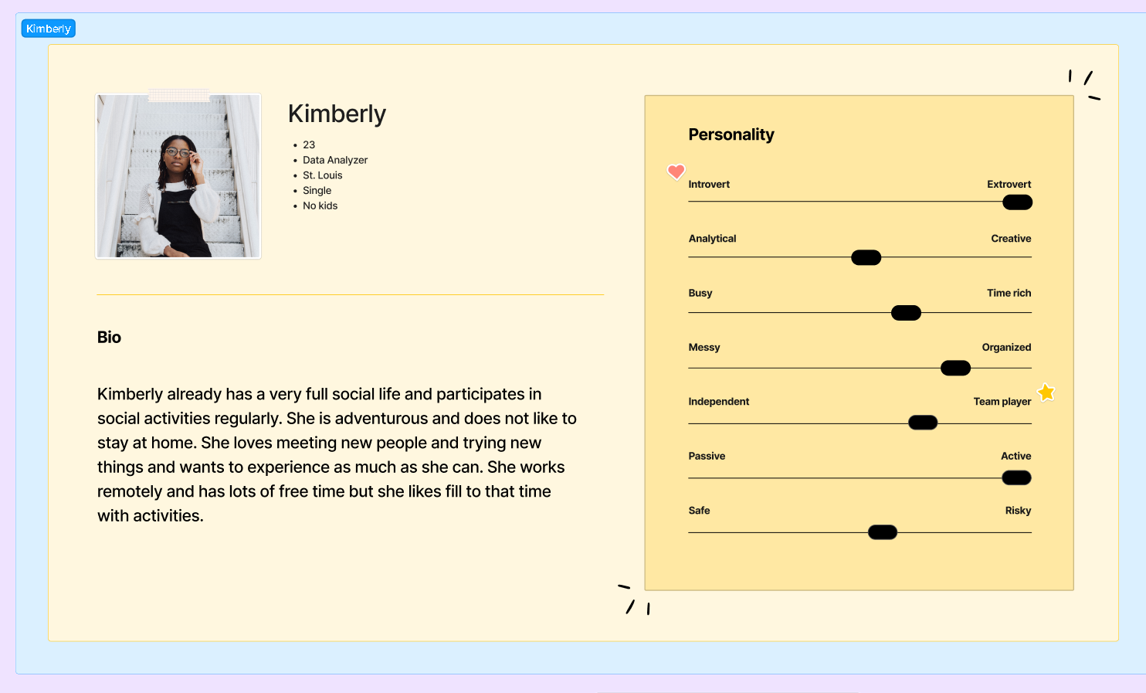

Slide 25
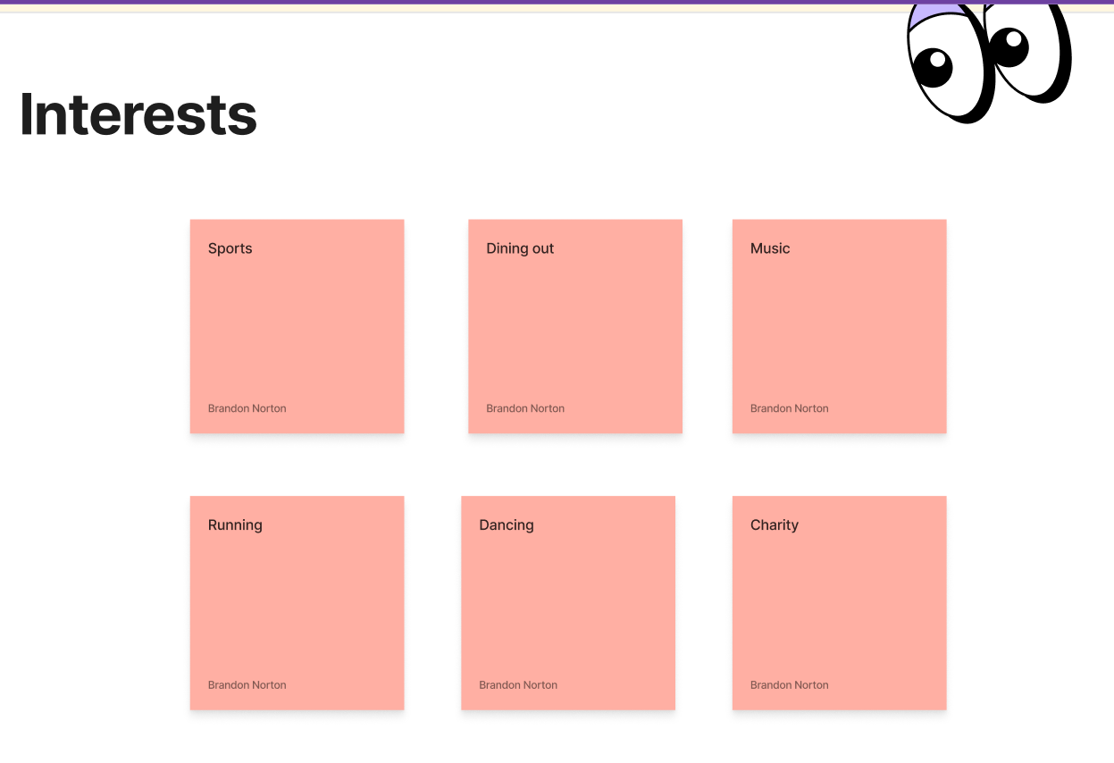
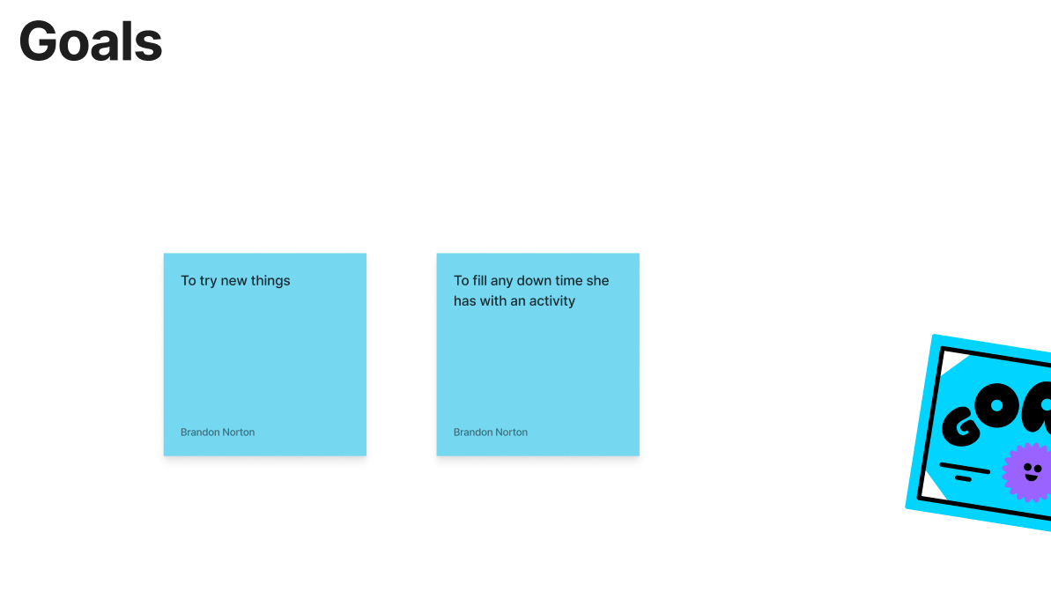
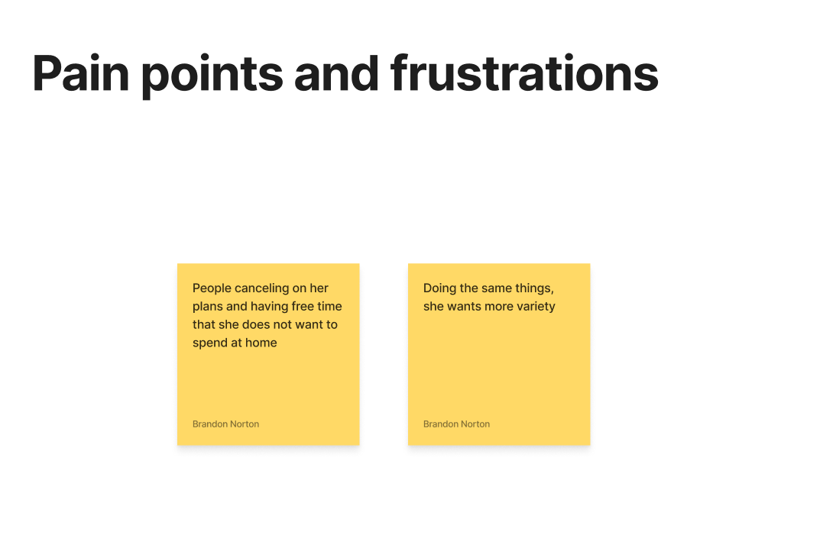
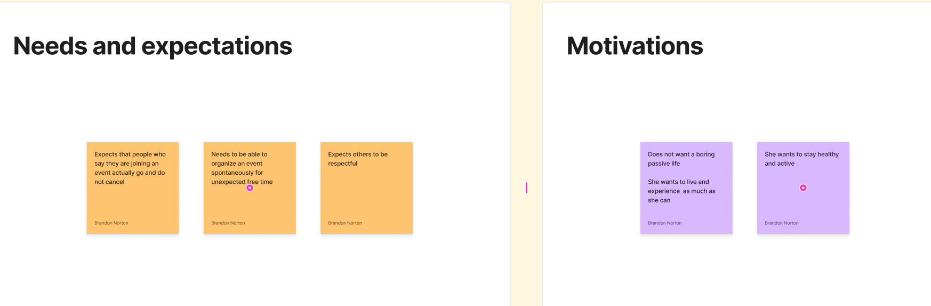

Slide 26
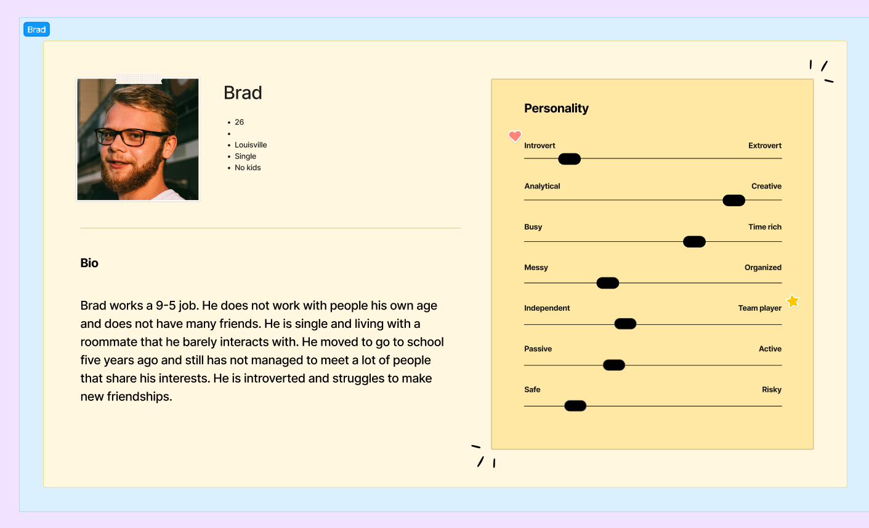

Slide 27
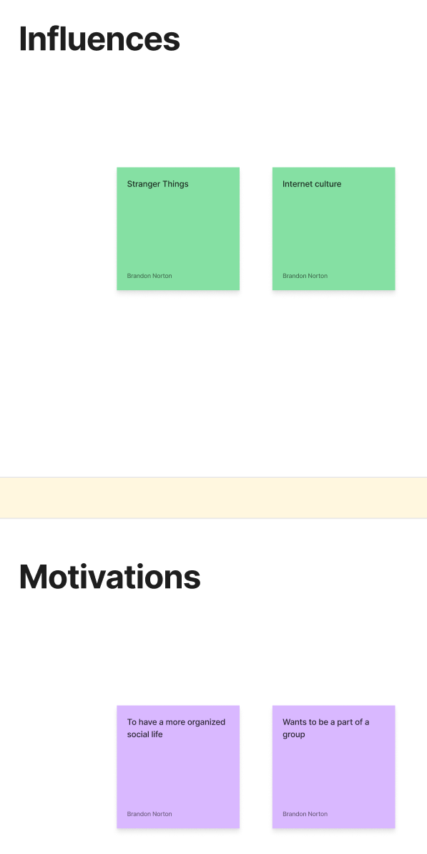
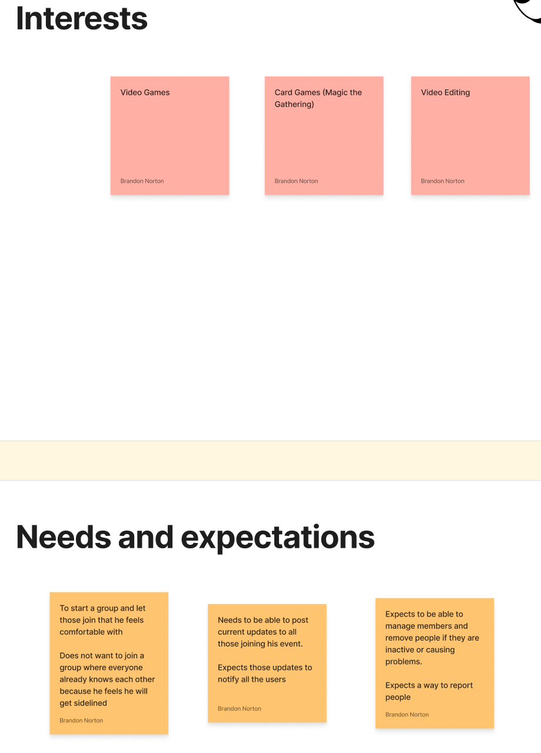
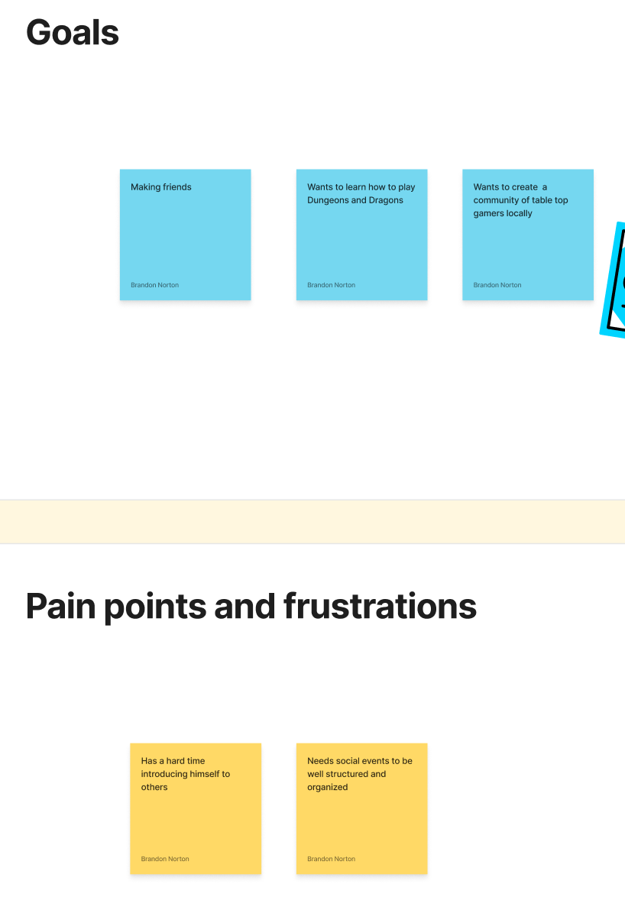

Slide 28
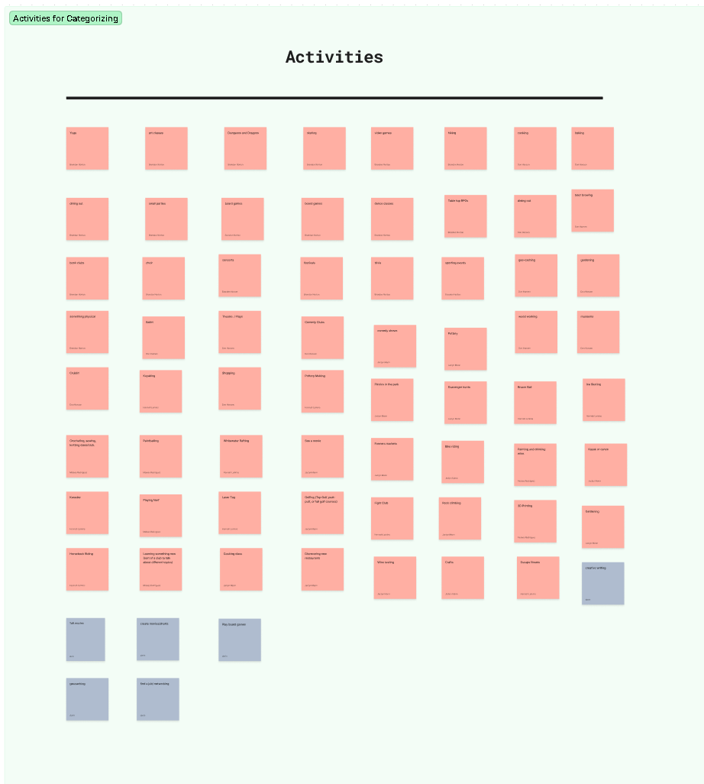
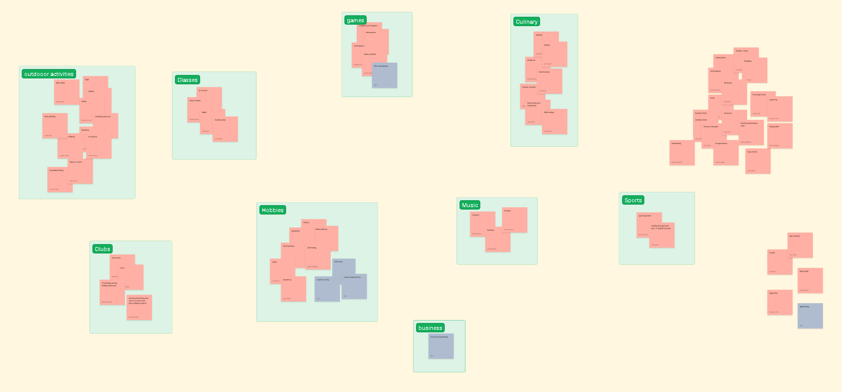
Staged an exercise with the team and listed possible activities and then grouped them to create categories

Slide 29
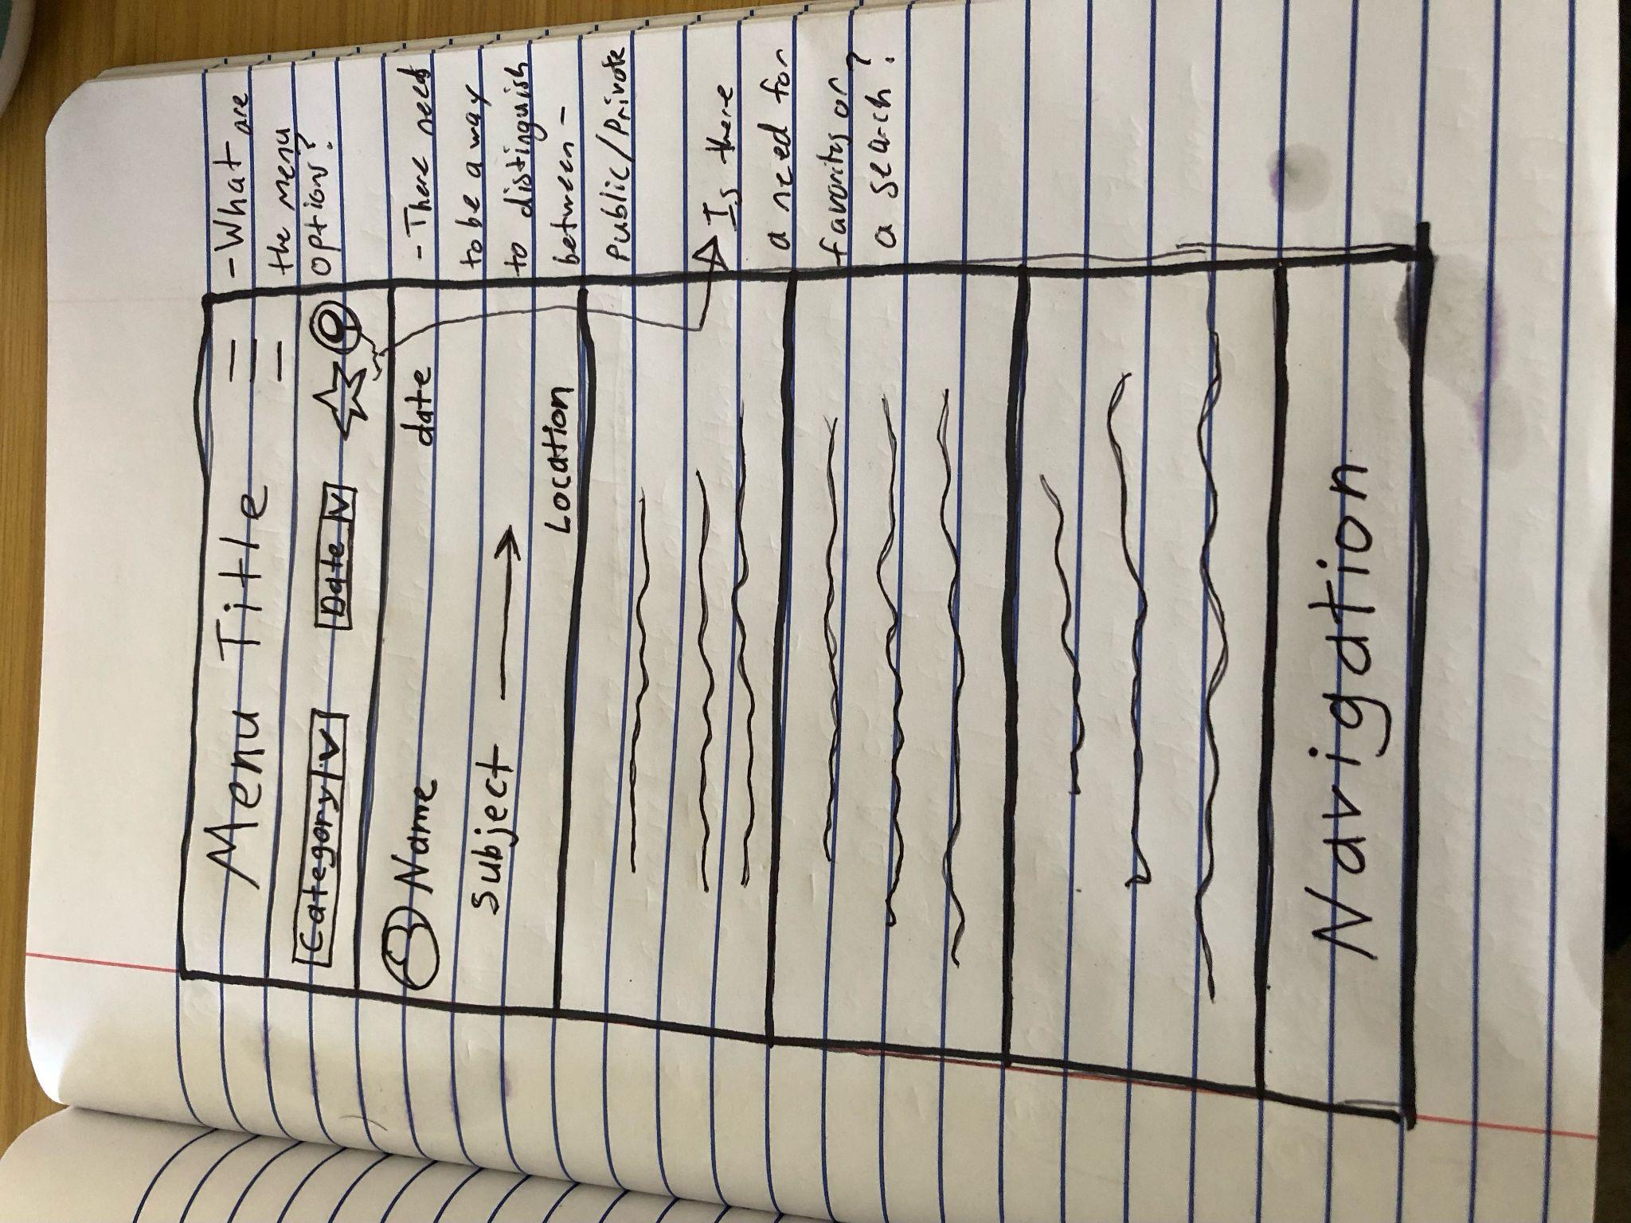
Initial Sketches
This would be under the explore or browse tab.
This is how a user would search through already posted events to join.
Location will just be city name, or city neighborhood name (Germantown)

Slide 30
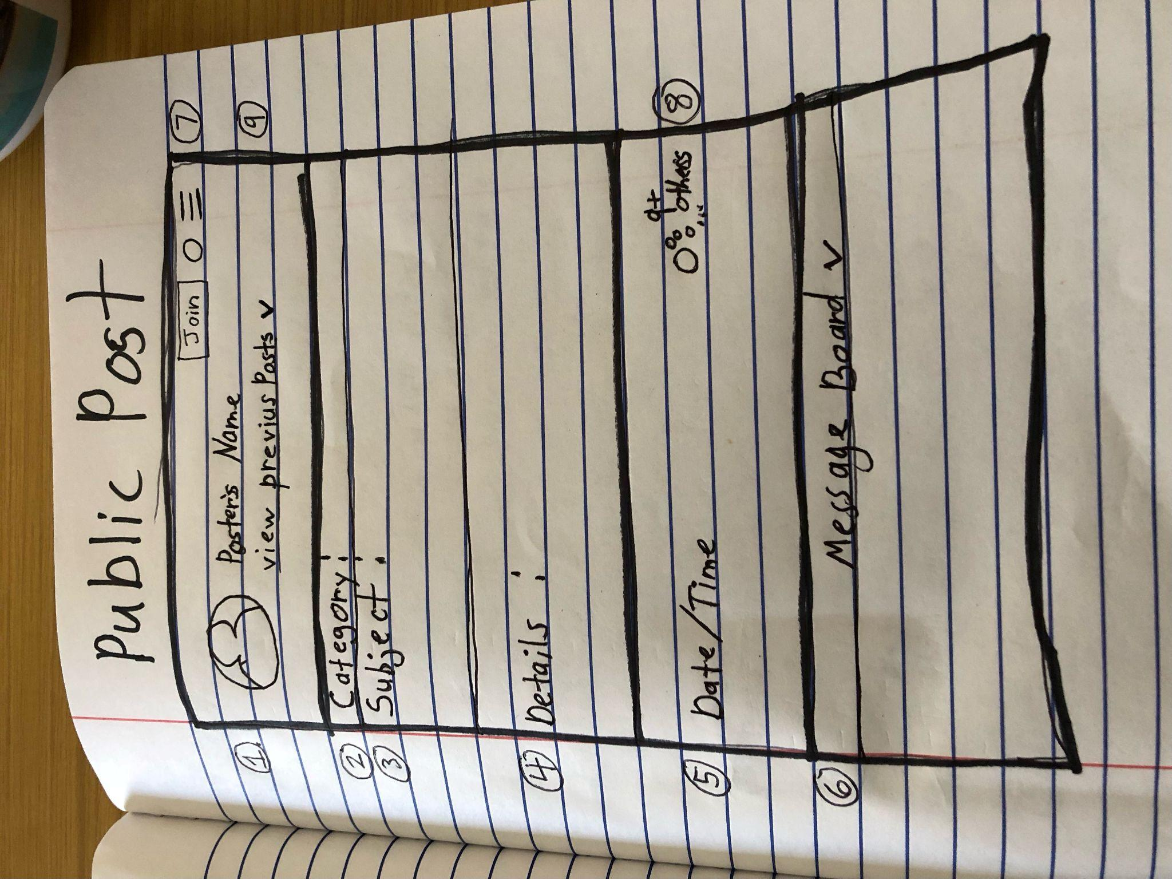
Shows User (Profile pic can be clicked to navigate to profile)
Shows what category this post is listed under
A brief headline for the subject matter of the Post.
Any additional details the Poster would like to explain the goal, expectations, and overall plan for this social event Post.
This will display date and time of this event
A message thread for this specific event (can only be seen if the user has joined the event).
A few options at the top right for user to interact with post.
Join: clickable button that sends join request to poster
Hamburger menu: report post, Dm Poster, remove post from search feed
An icon that shows if and how many others are joining this event
Clickable button to take user to look through the Posters previous events created (helps users decide if they want to meet)

Slide 31
User Journey Map
Brad

Slide 32
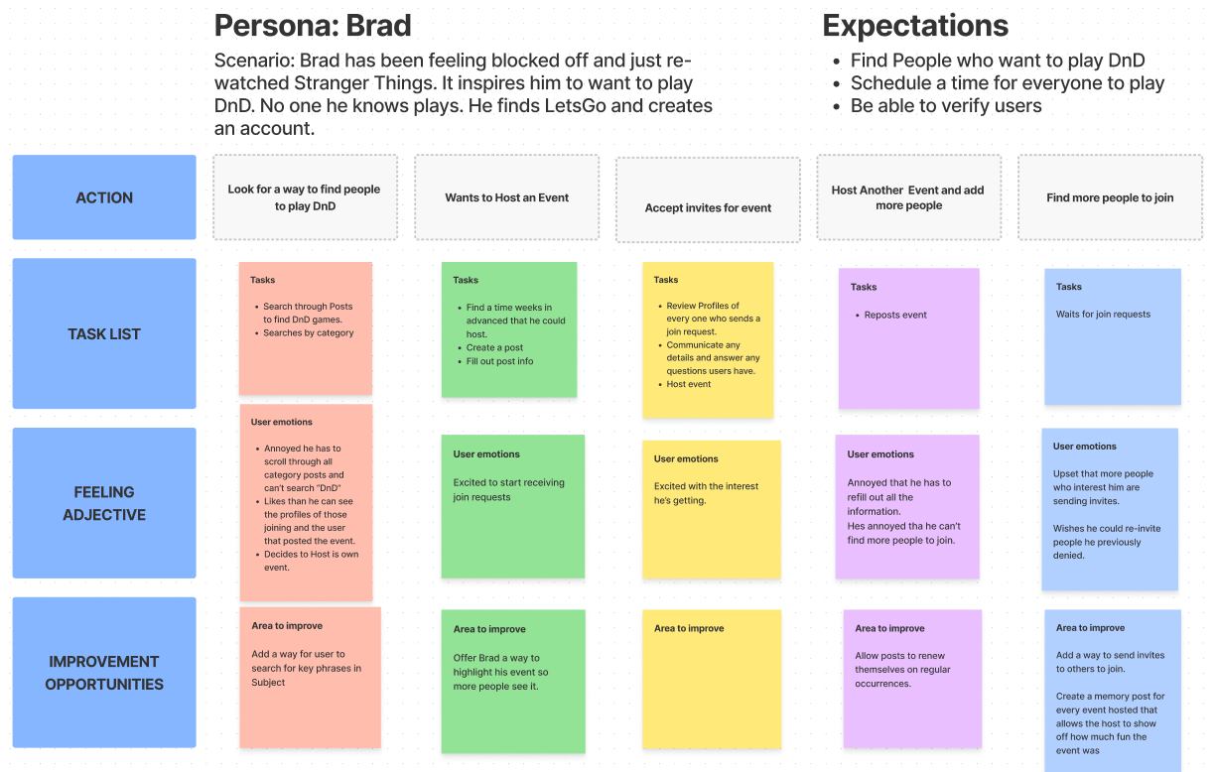

Slide 33
Next Steps
Create a User Flow for creating a post
Use Brads Journey map to iterate over another design phase.
Create more Journey Maps for every persona

